Slide 1
CIS 55 – iOS Programming
Manish Goel

Slide 2
Lecture Objectives
Guessing Game App
Continue our ToDo List App

Slide 3
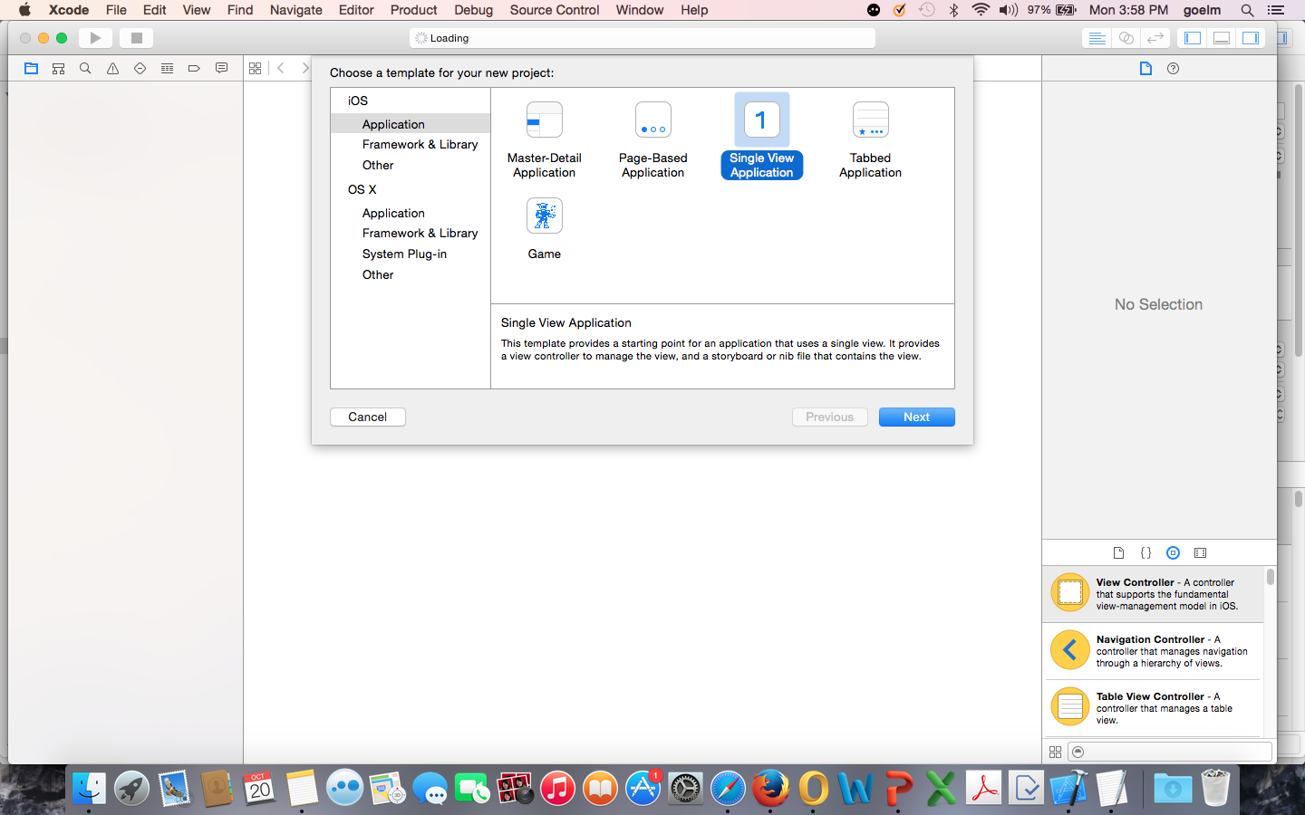
iOS Guessing App in Swift

Slide 4
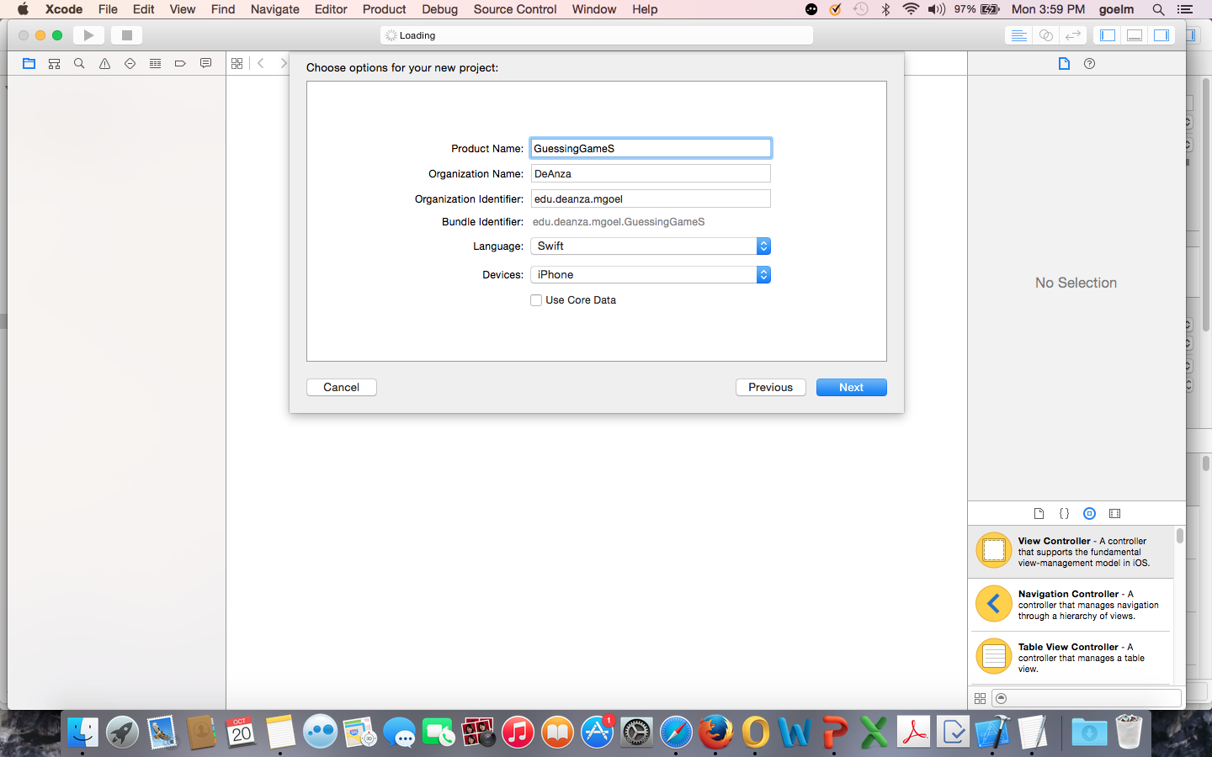

Slide 5
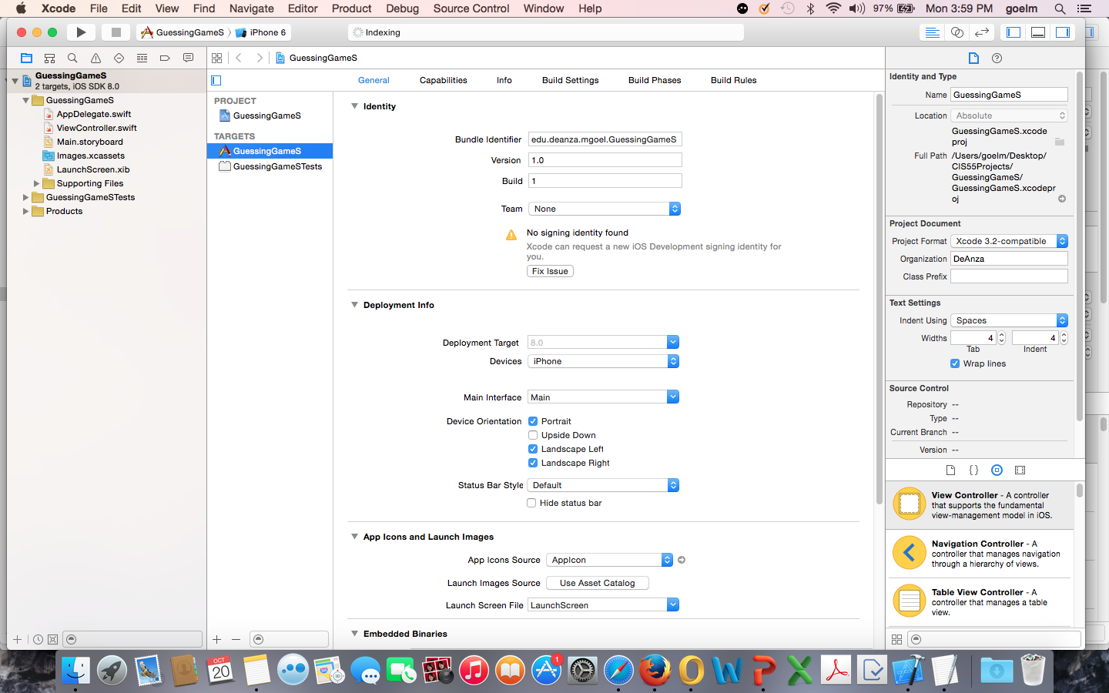

Slide 6
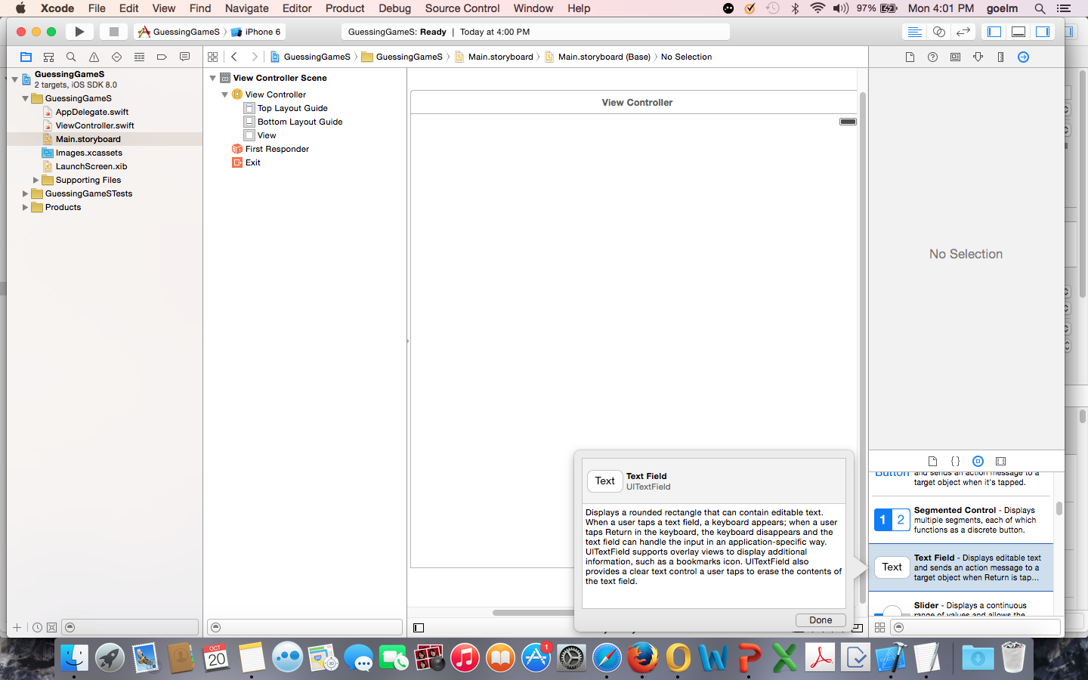
Haven’t set iPhone size – controls could be off-center

Slide 7
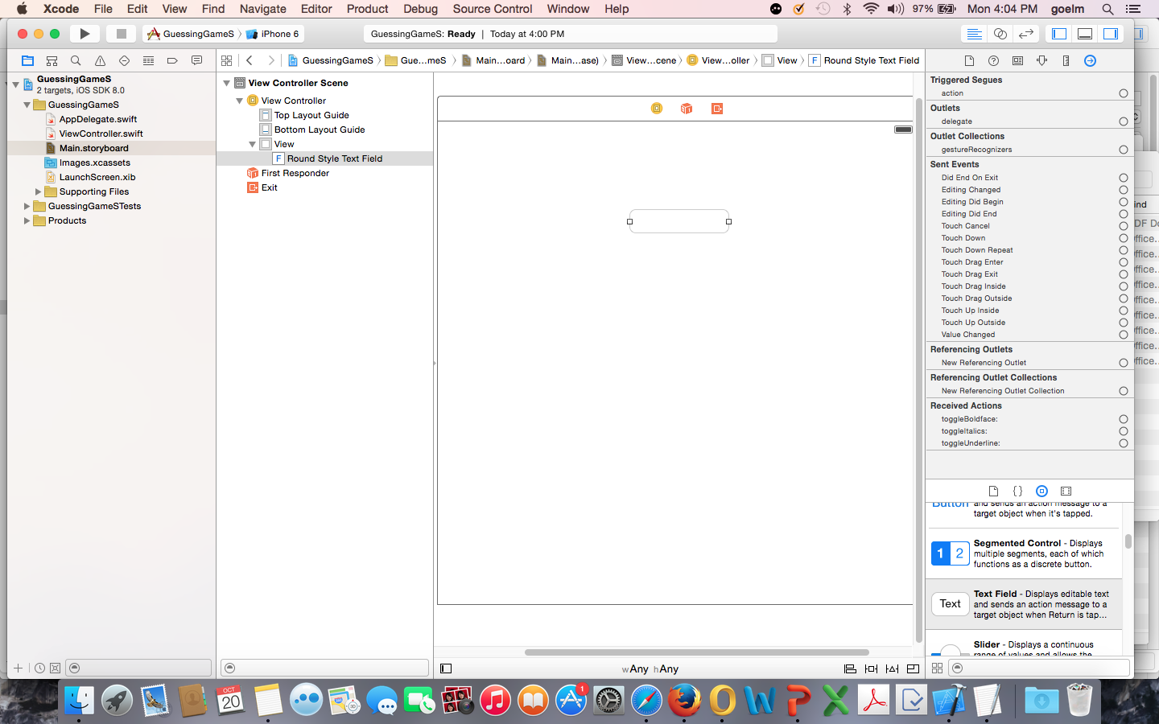

Slide 8
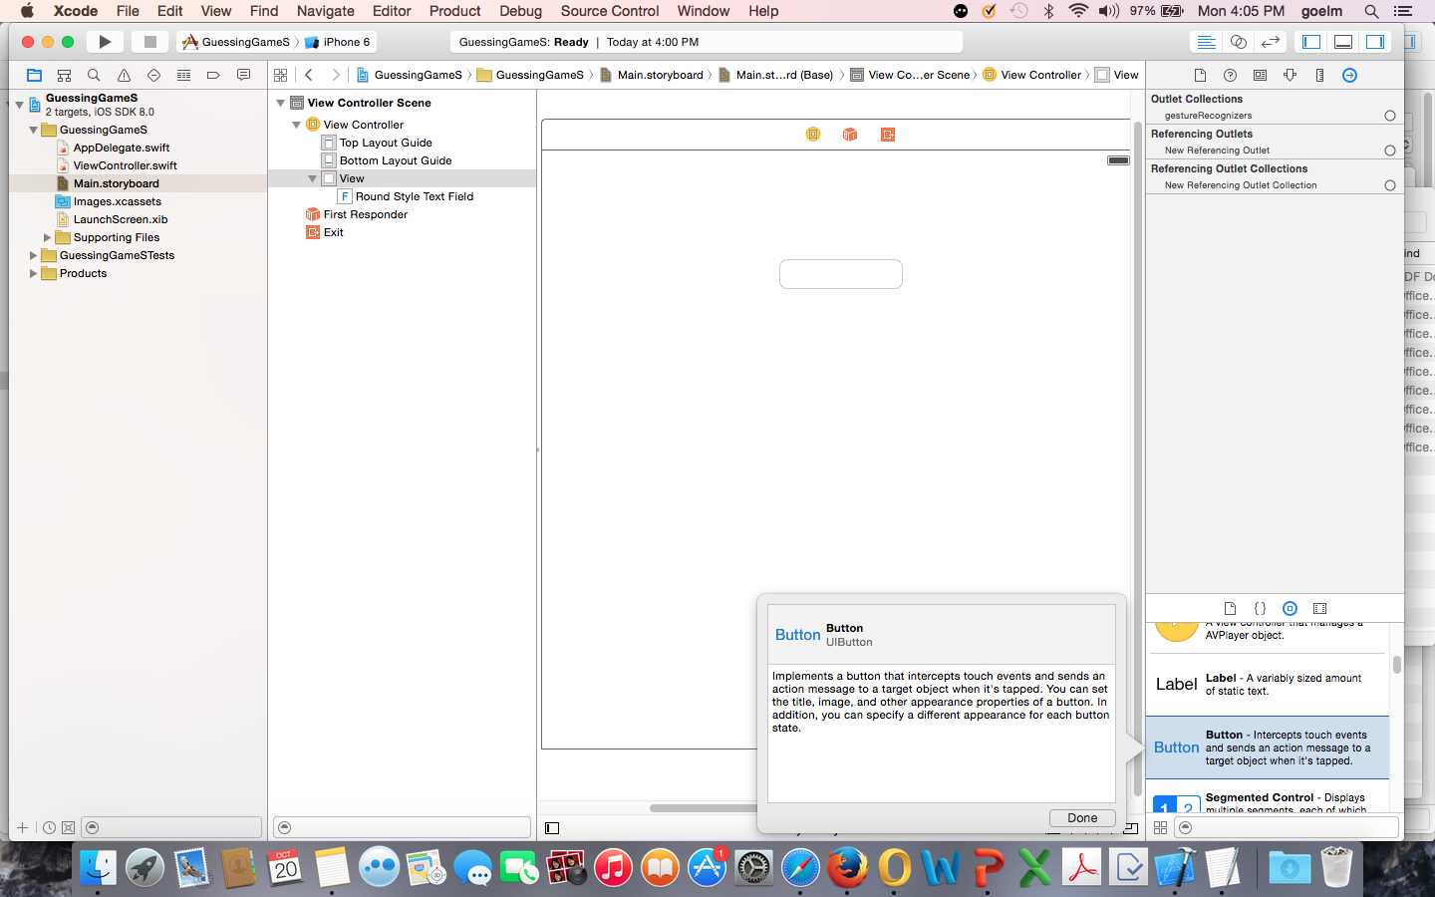

Slide 9
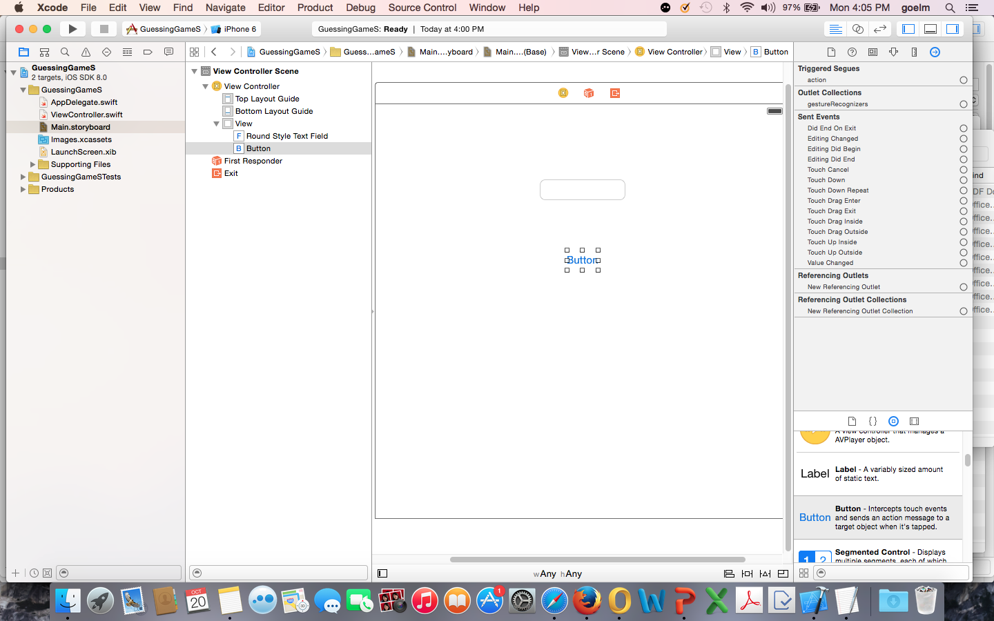

Slide 10
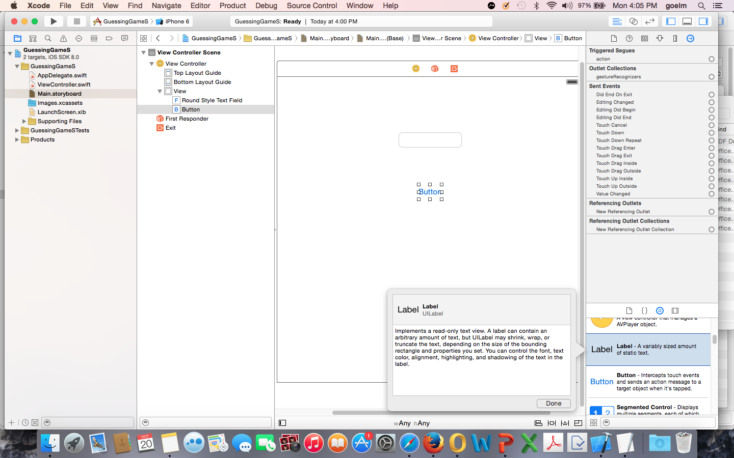

Slide 11
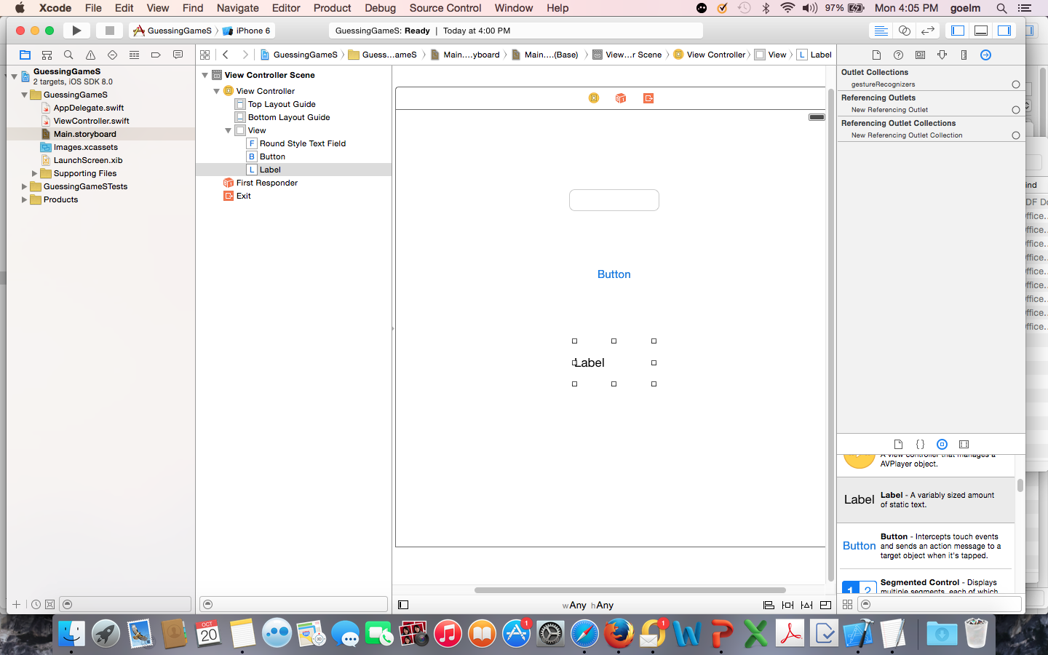

Slide 12
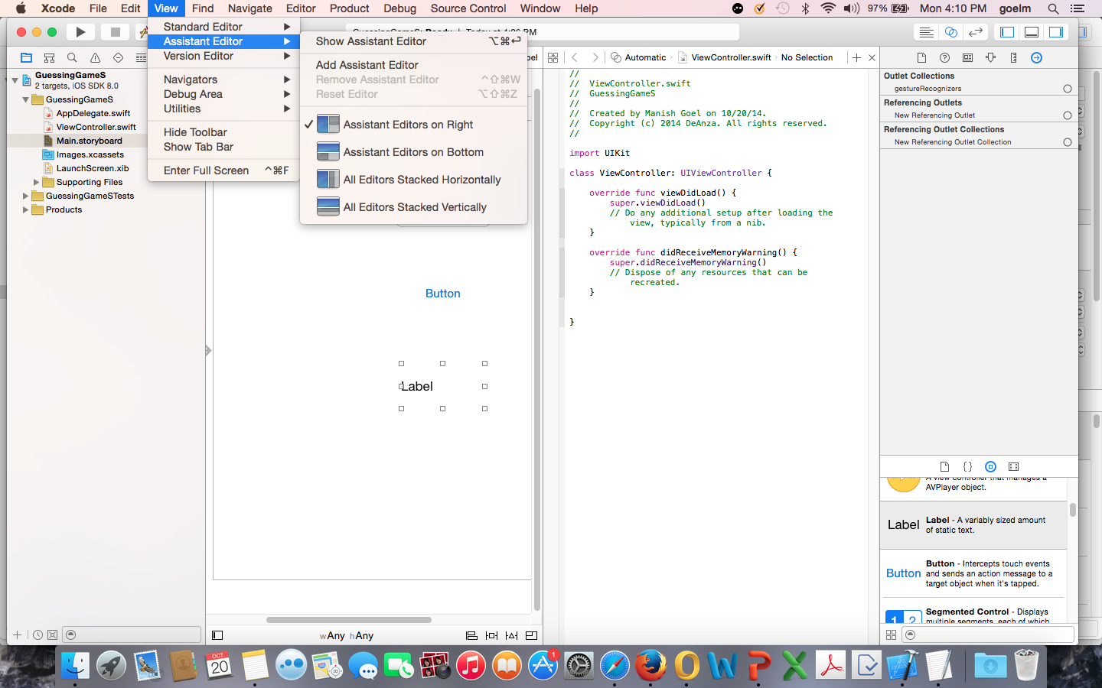

Slide 13
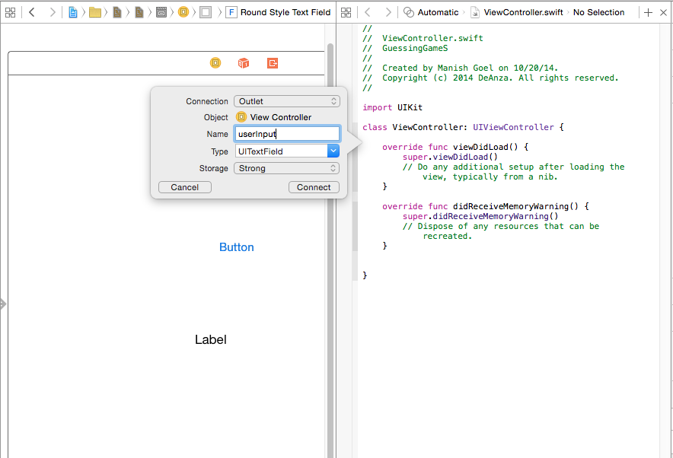
Ctrl-click-drag to before func’s to create outlets for your textfield and your label and action for your button

Slide 14
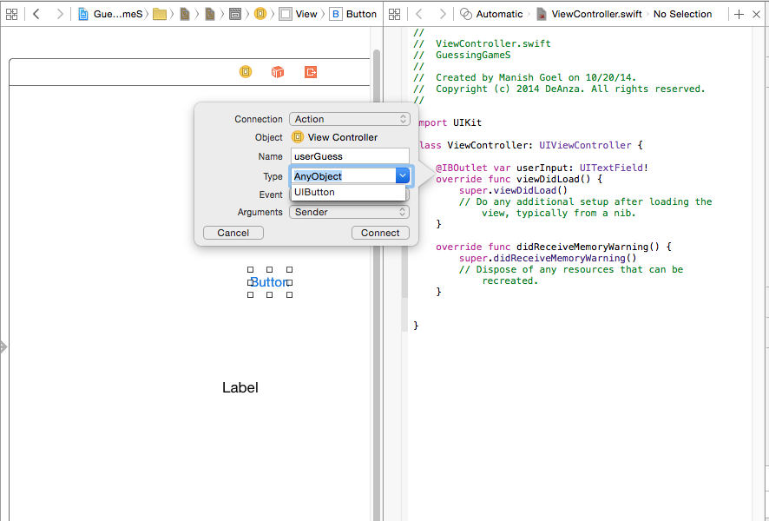

Slide 15
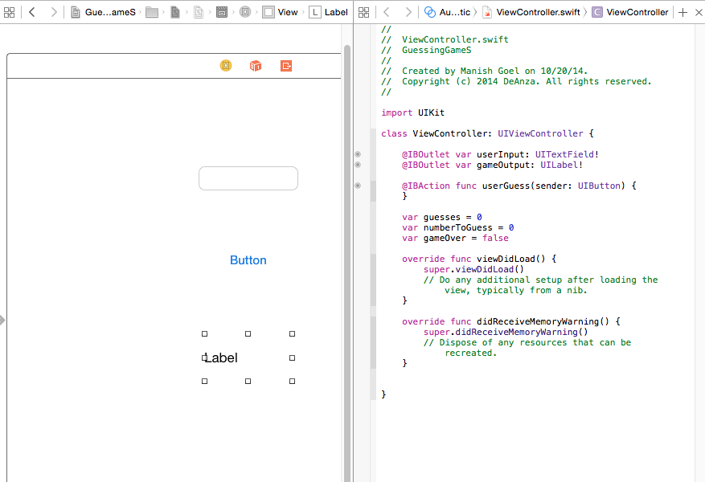
Our outlets and action

Slide 16
Variables to set the initial state of our app

Slide 17
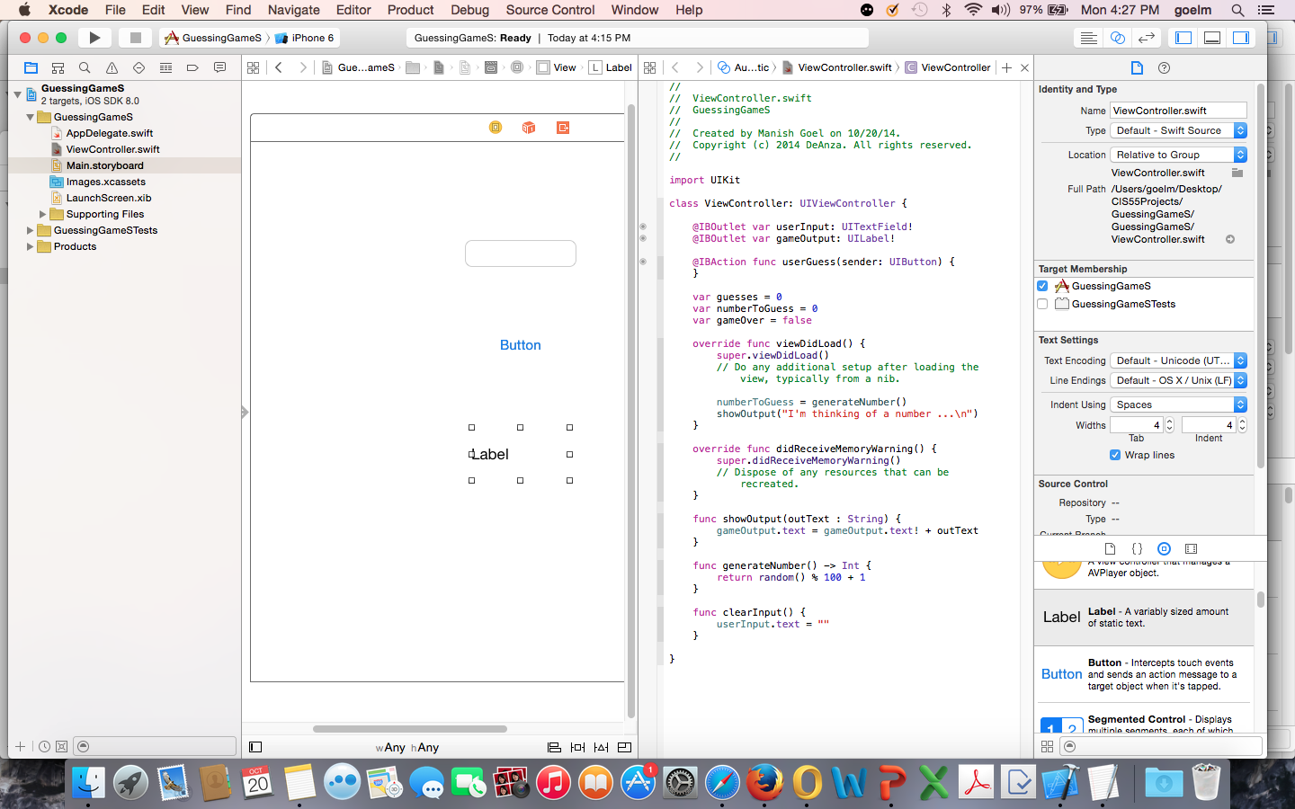
Set up the initial state when app is launched

Slide 18
Our helper functions

Slide 19
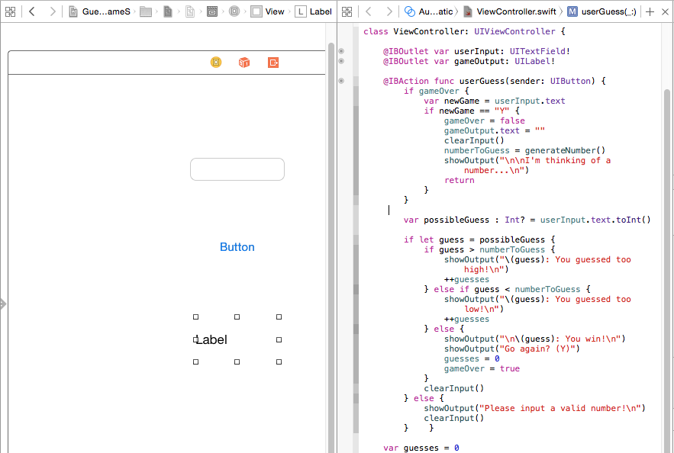
For our app to do anything useful, the button action needs code

Slide 20
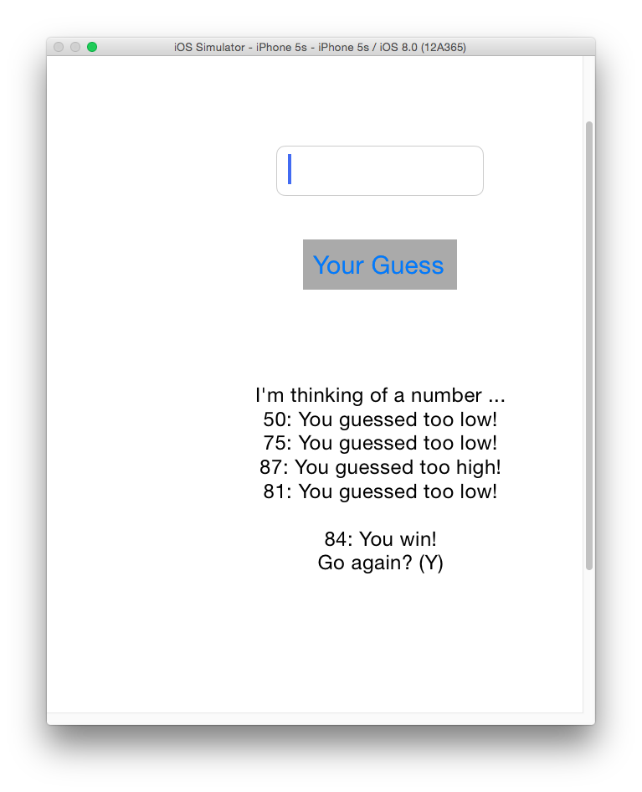
Note:
The label and background color of the button has been changed to provide context to app user

Slide 21
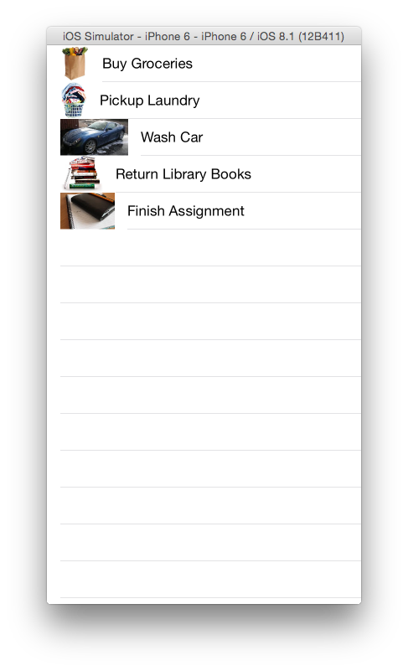

Slide 22
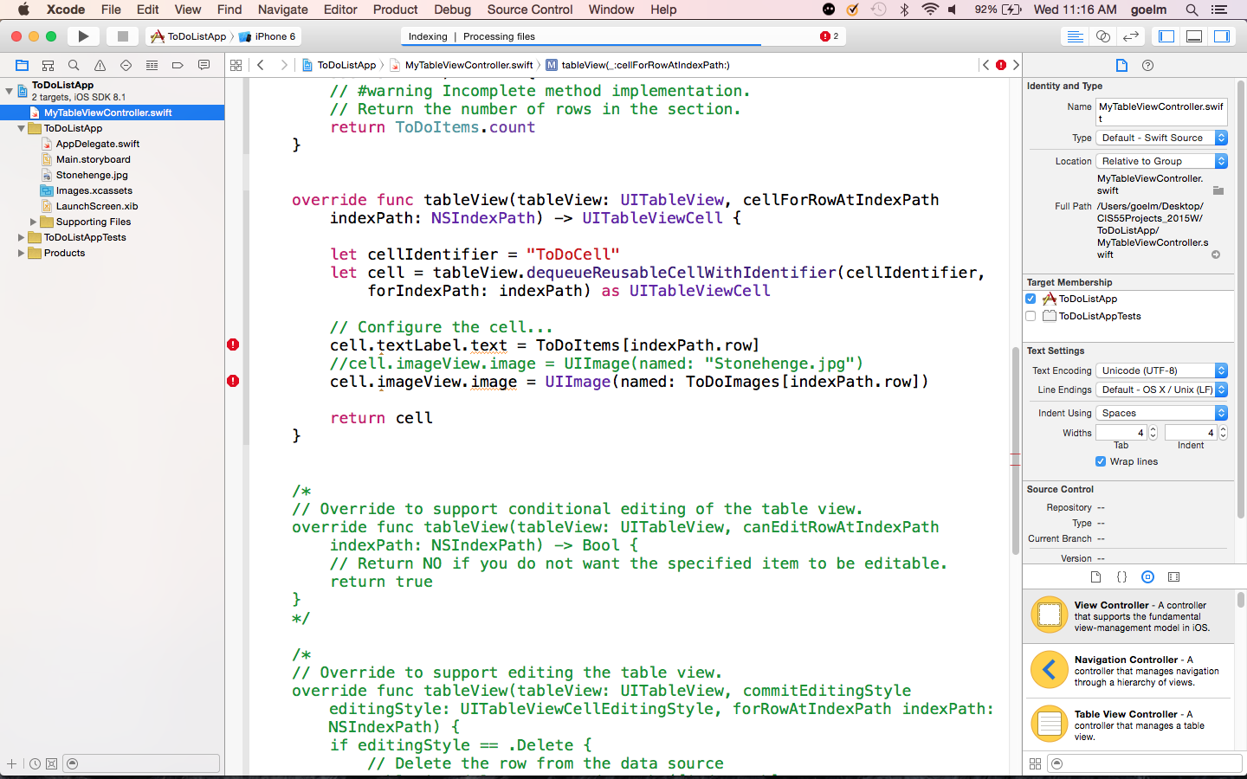
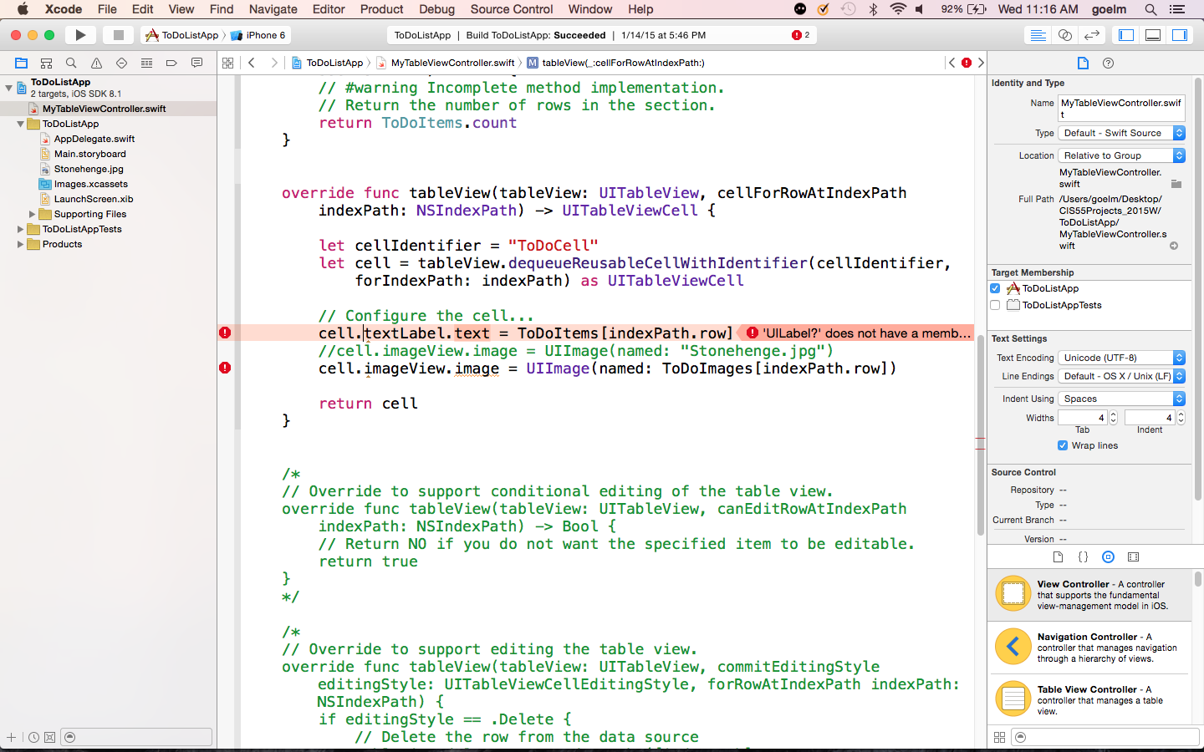
Upgrading to Xcode 6.1.1 gives errors in code that was working on Xcode 6.0.1 – demonstrates that be very careful when upgrading Xcode – do not set to Auto Update

Slide 23
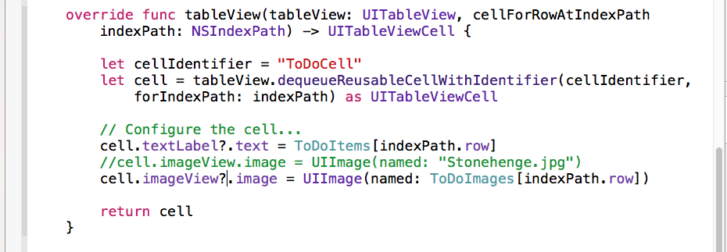
To fix – use the hint provided by the IDE – insert a ‘?’ on the two lines above.
The ‘?’ inserted indicates “explicit optional unwrapping”.
Sometimes ‘!’ may need to be inserted – this is “implicit optional unwrapping”.
Optionals are new data types in Swift that can take the form of any data type
- Also known as “polymorphic” behavior. However, you have to depend on the IDE to guide you on when to use which type of unwrapping.

Slide 24
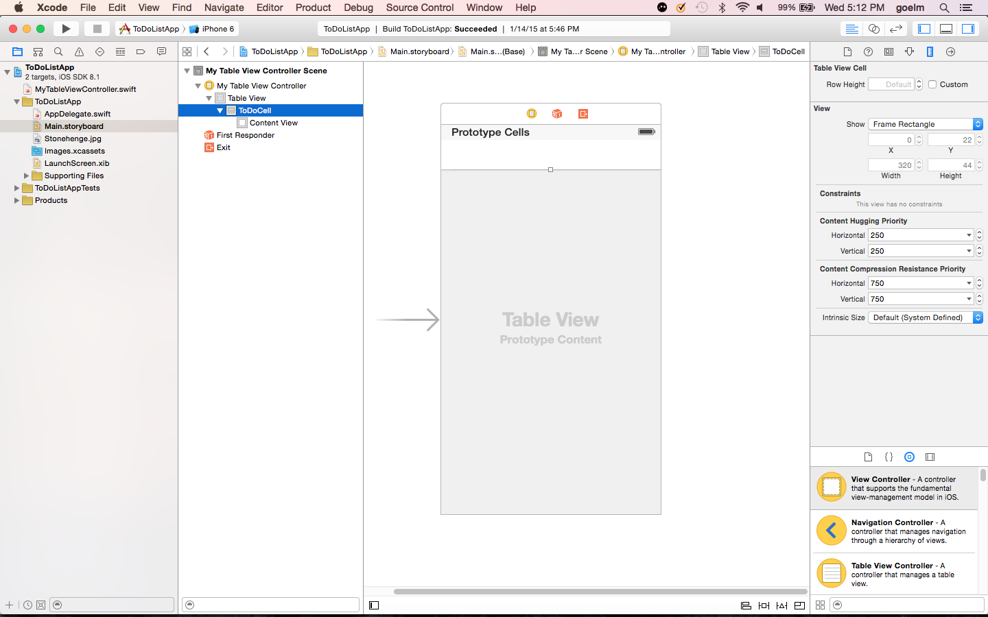

Slide 25
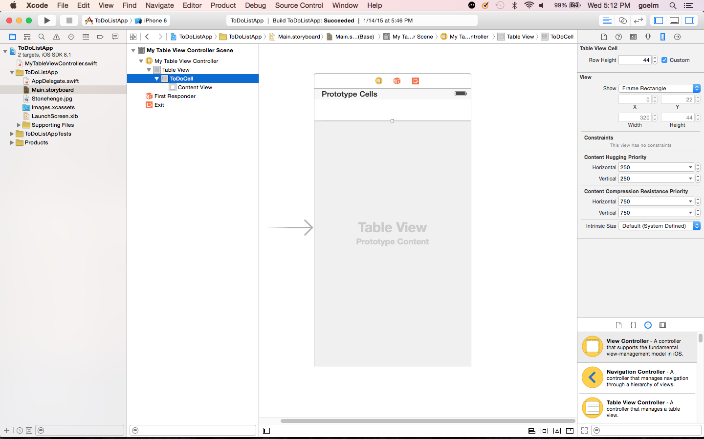

Slide 26
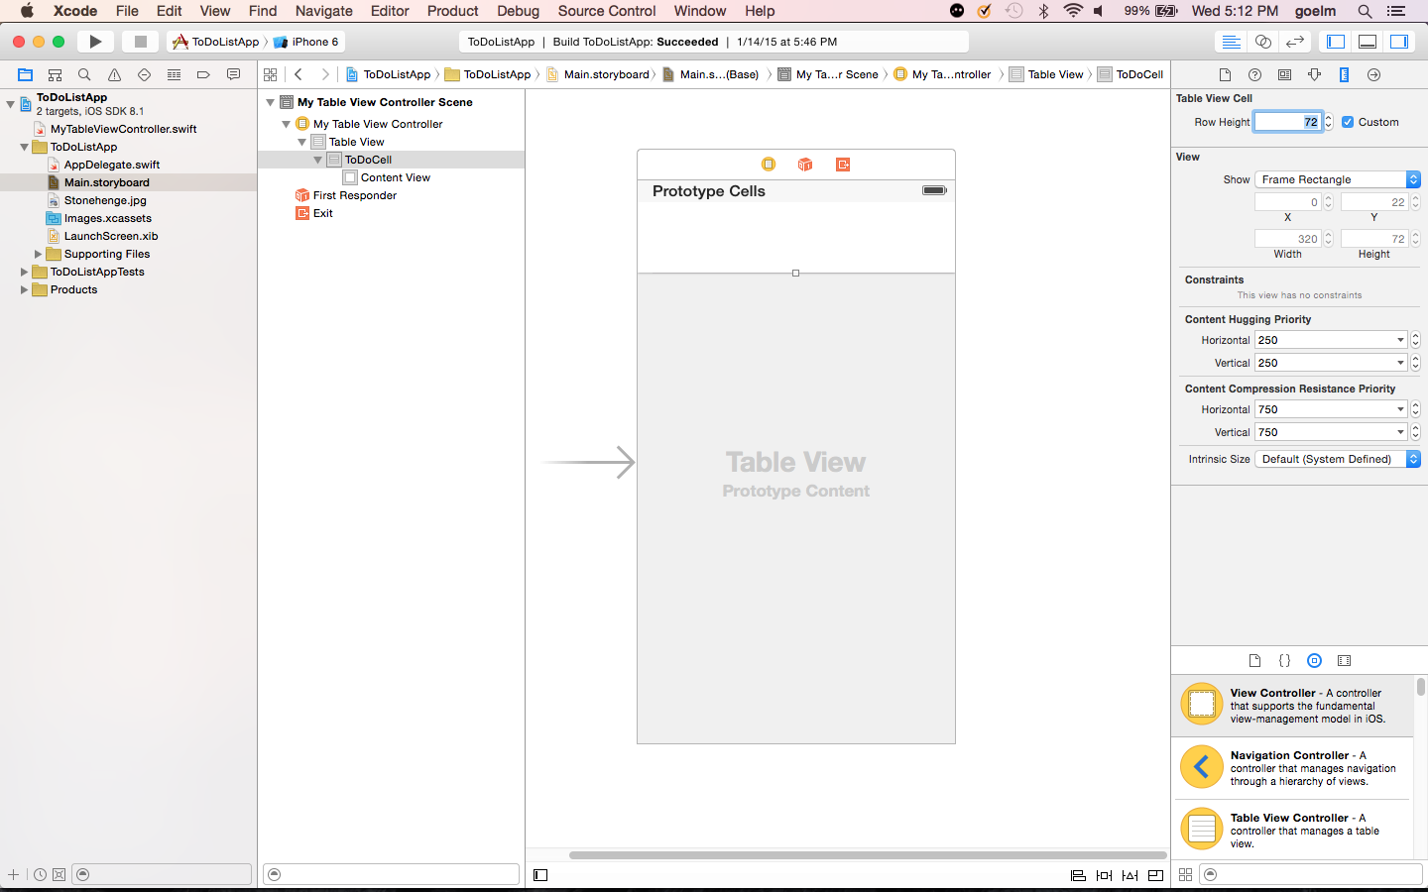

Slide 28
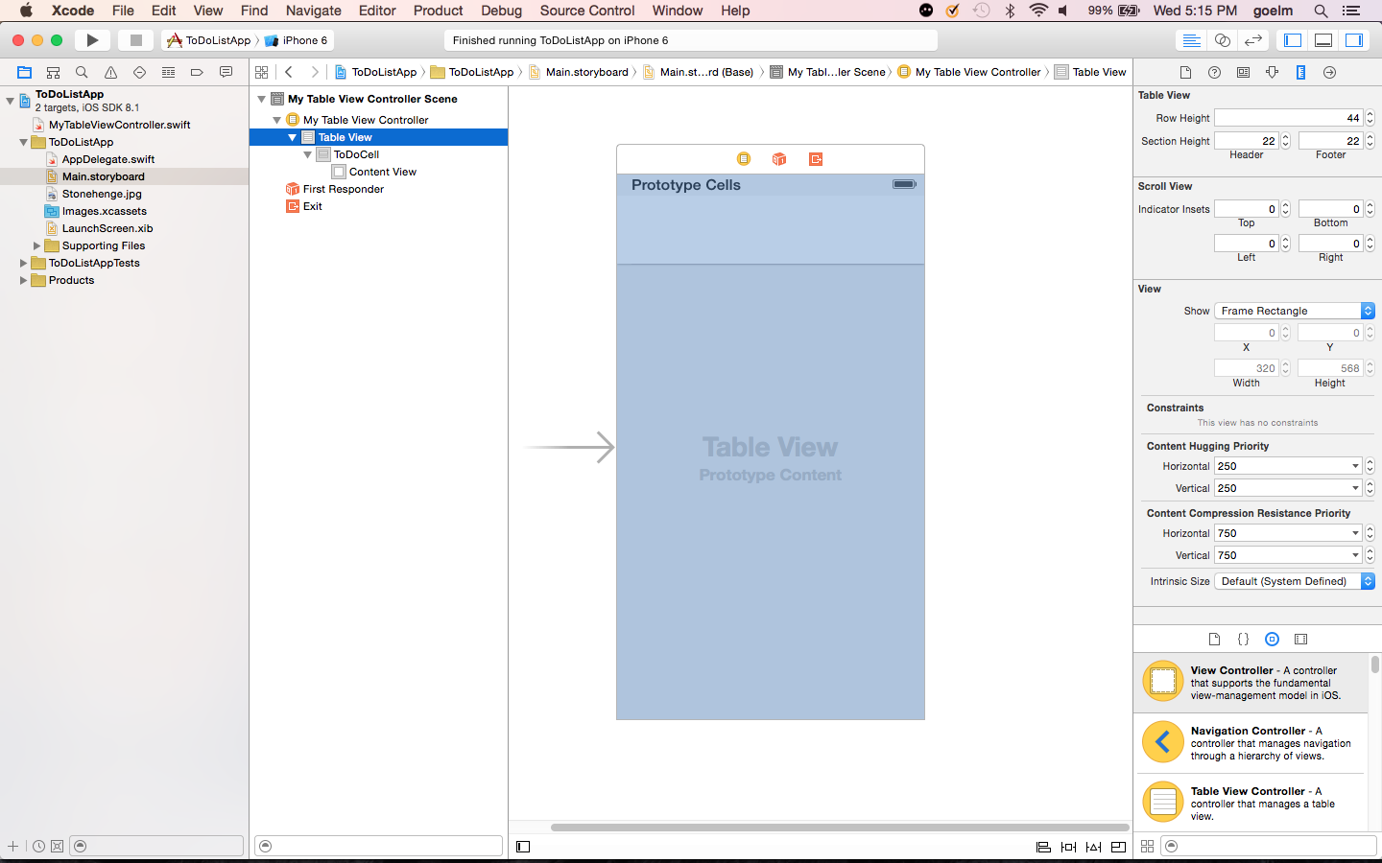

Slide 29
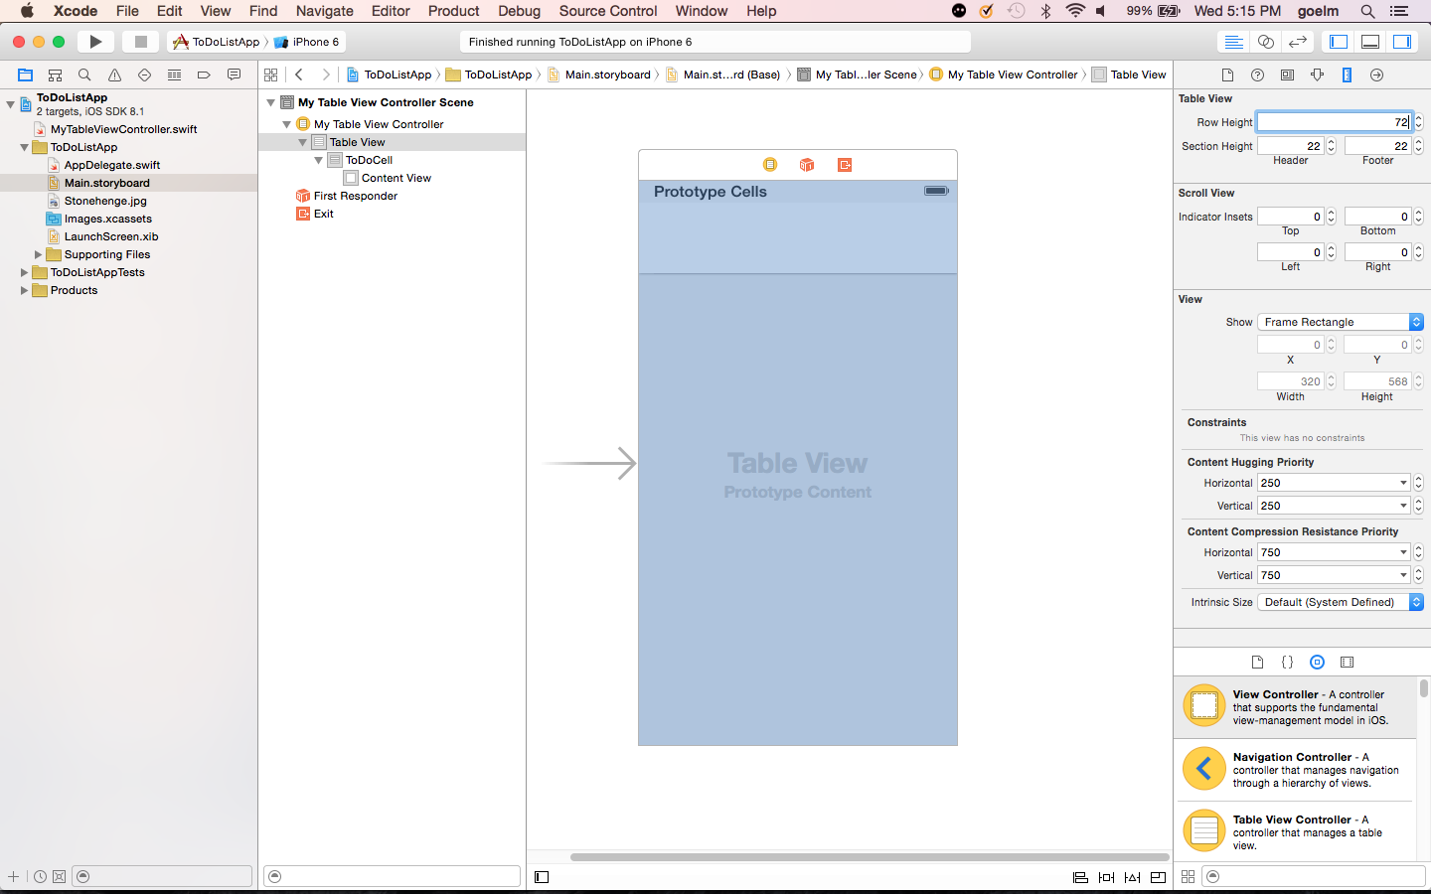

Slide 30
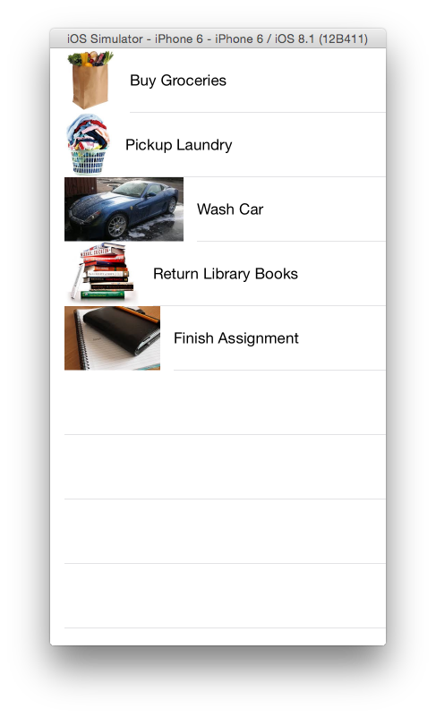

Slide 31
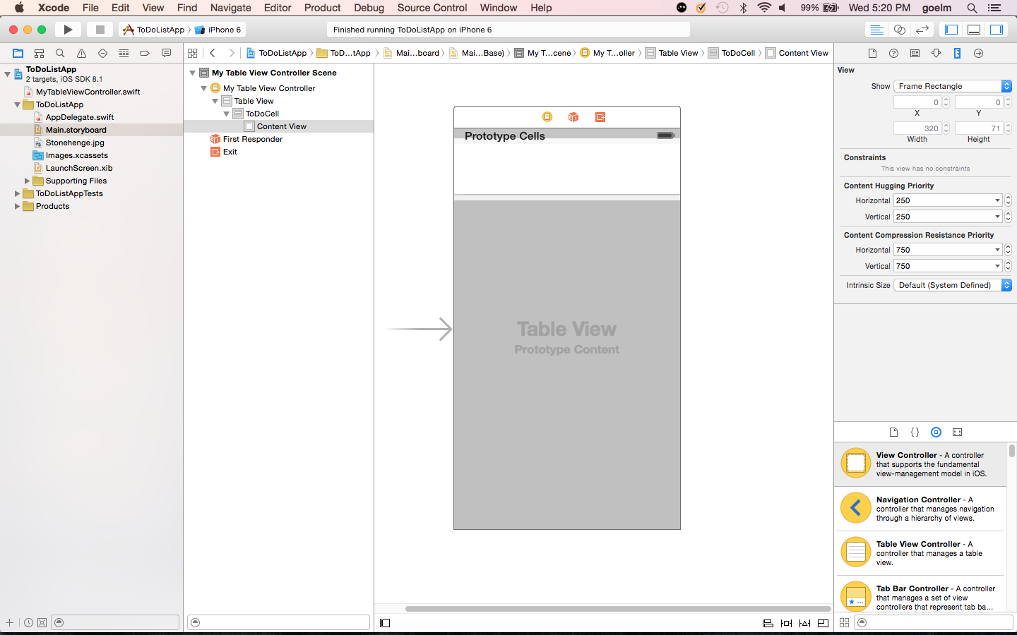

Slide 32
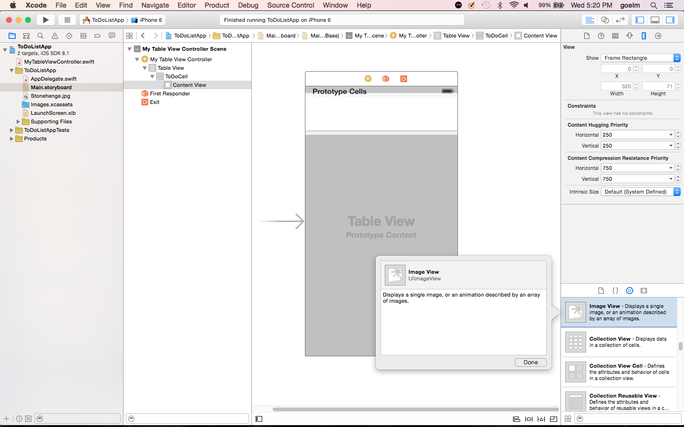

Slide 33
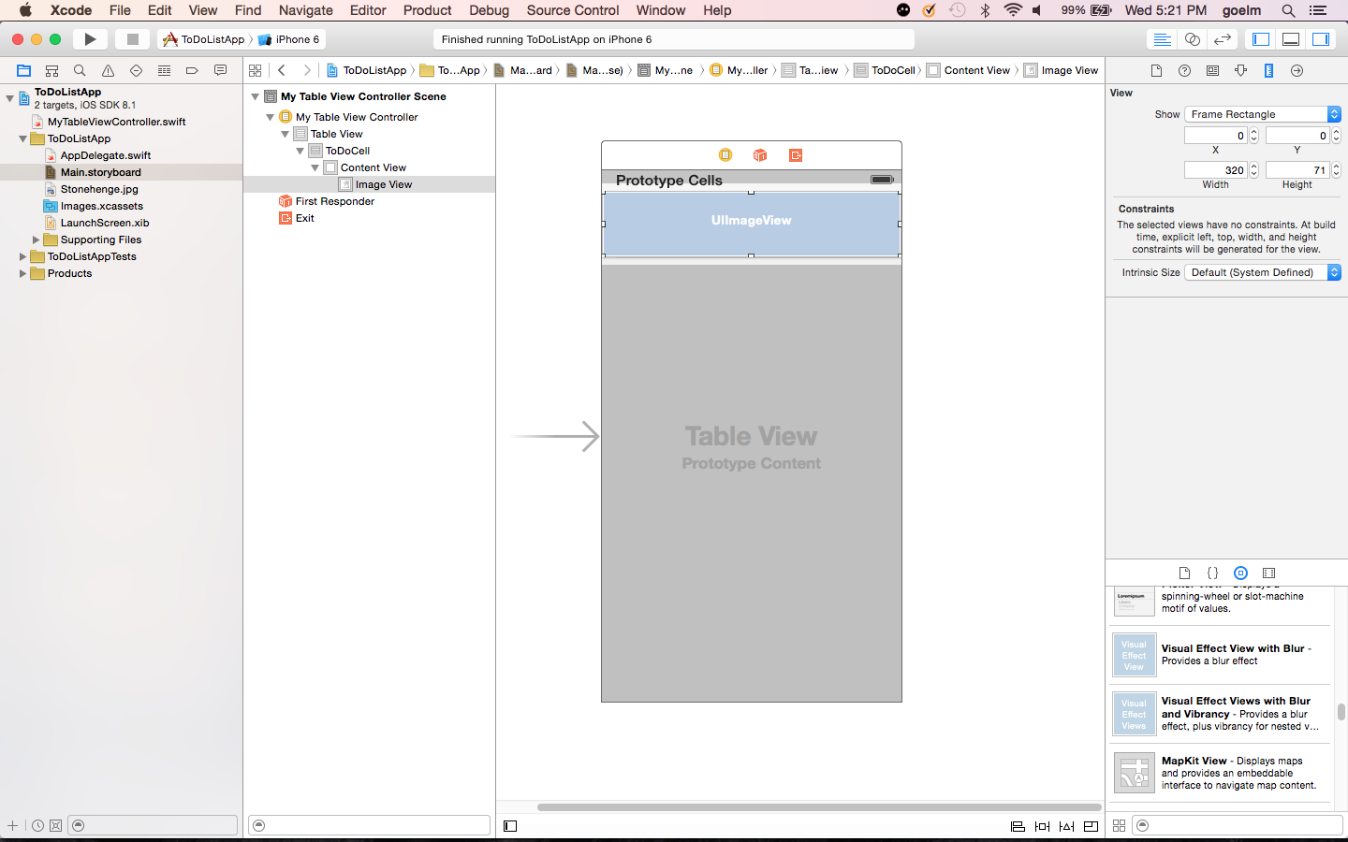

Slide 34
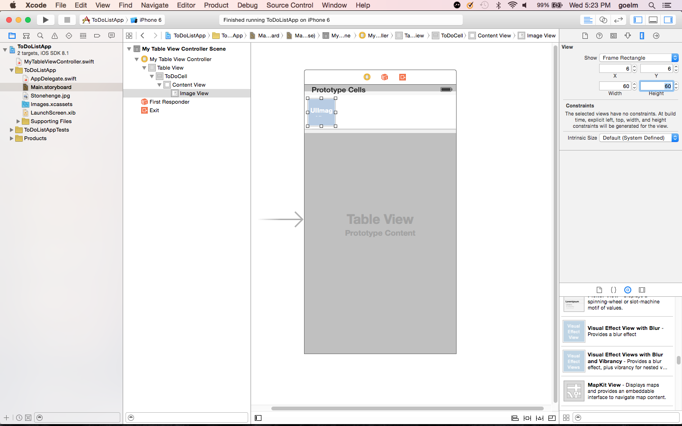

Slide 35
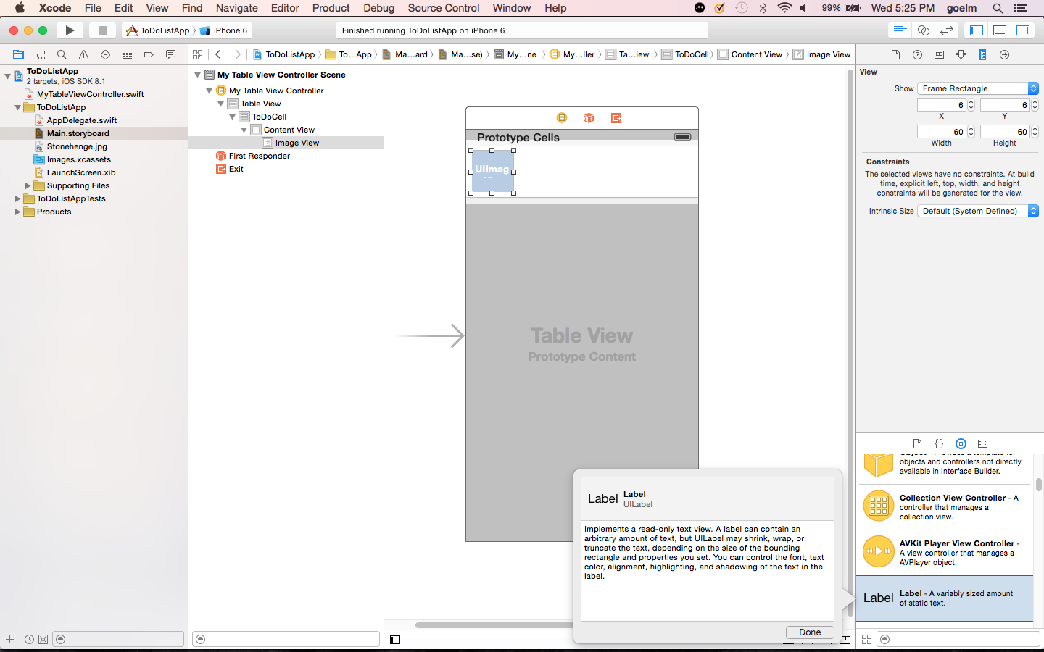

Slide 36
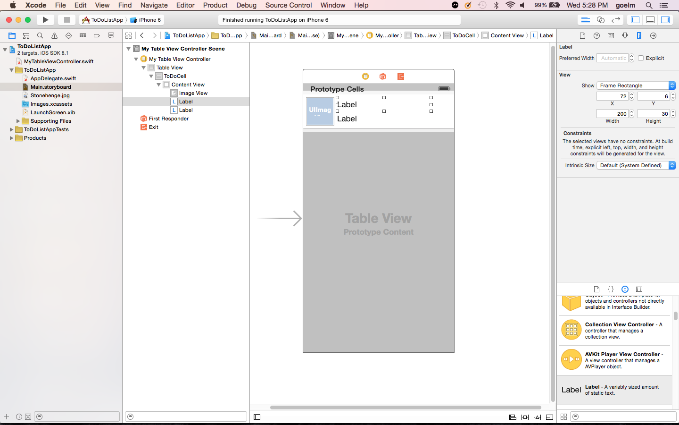

Slide 37
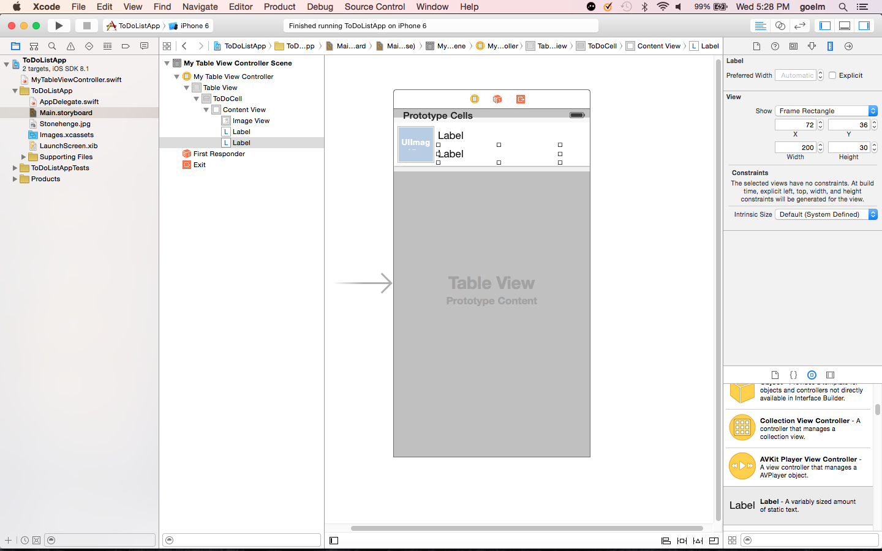

Slide 38
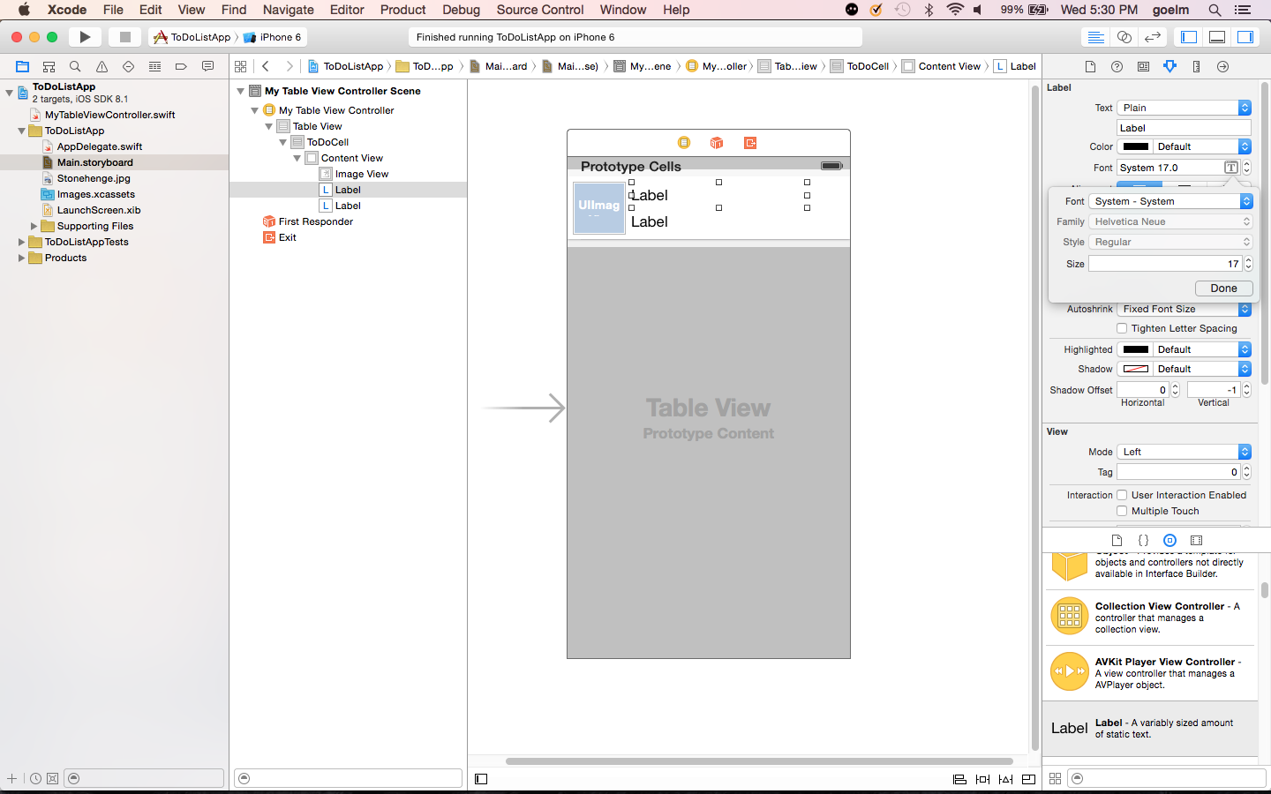

Slide 39
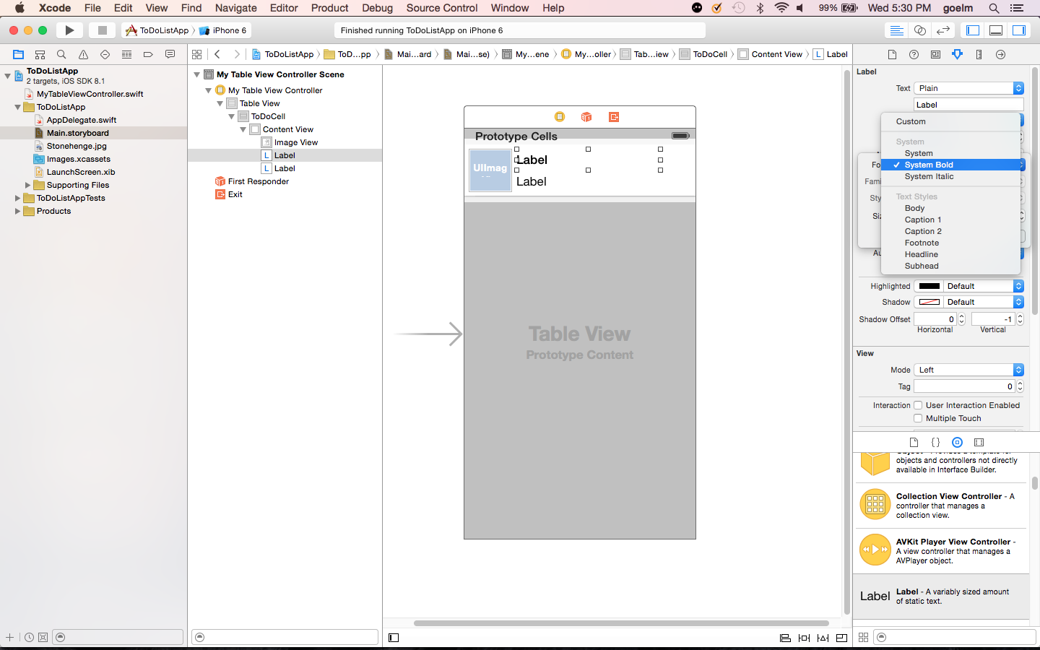

Slide 40
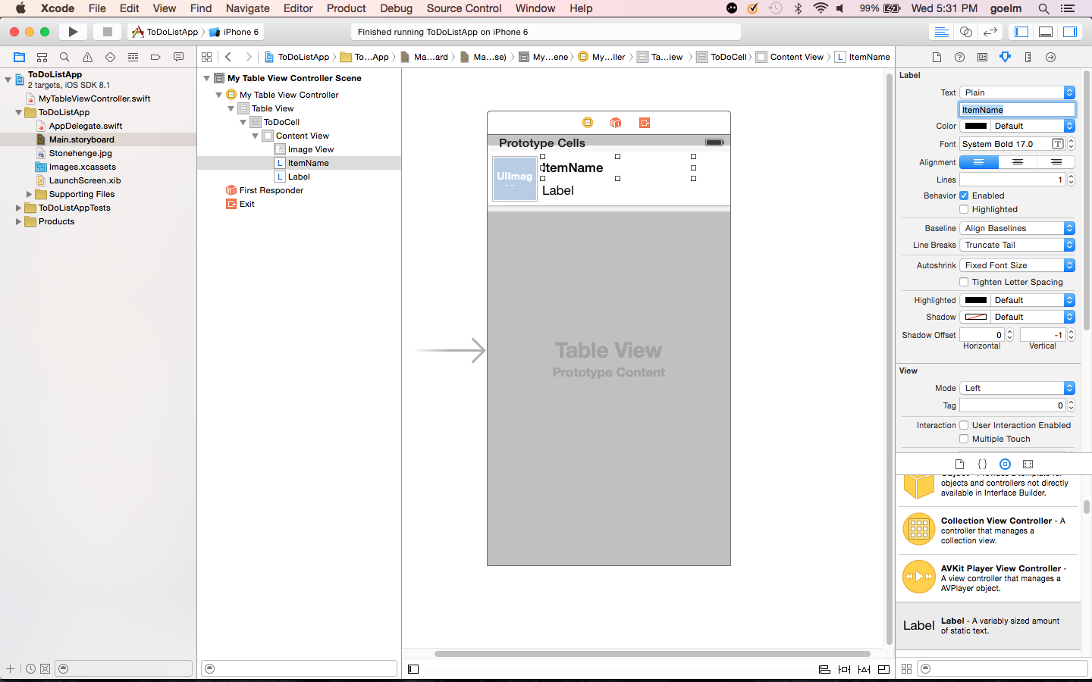

Slide 41


Slide 42
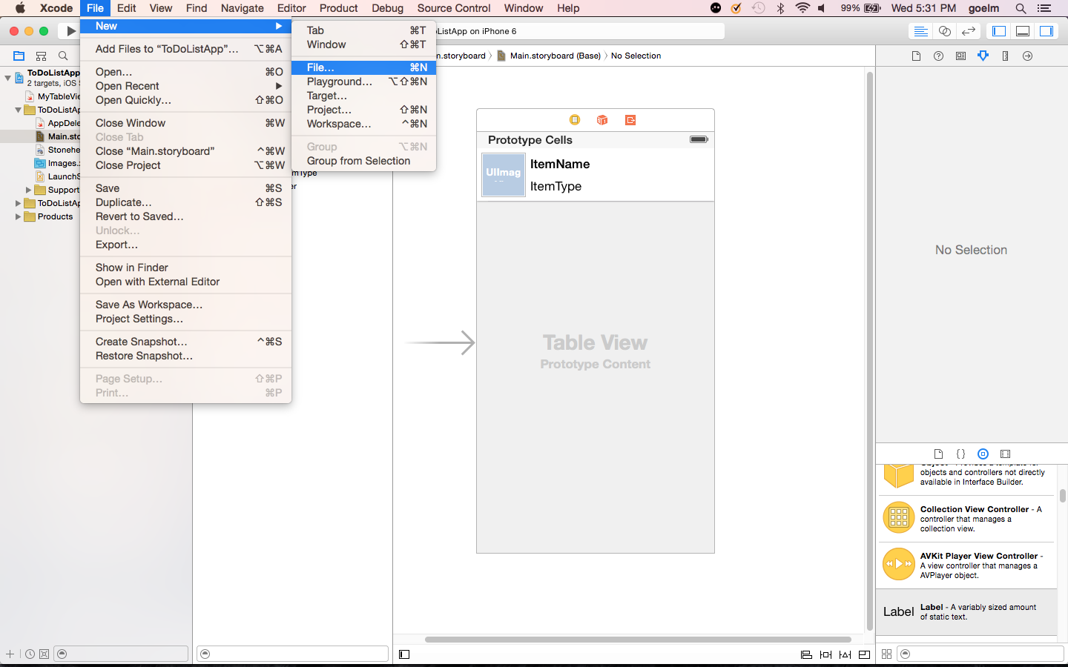

Slide 43
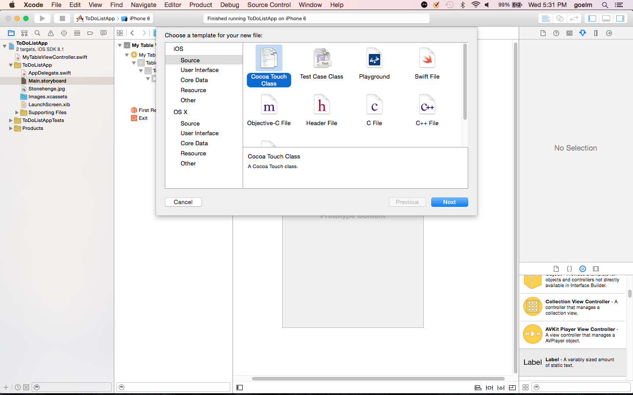

Slide 44
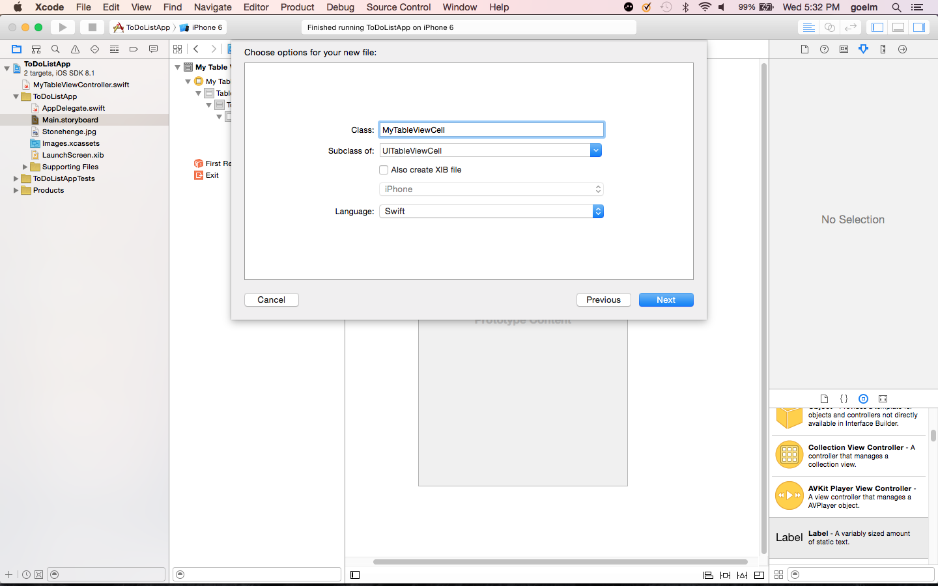

Slide 45
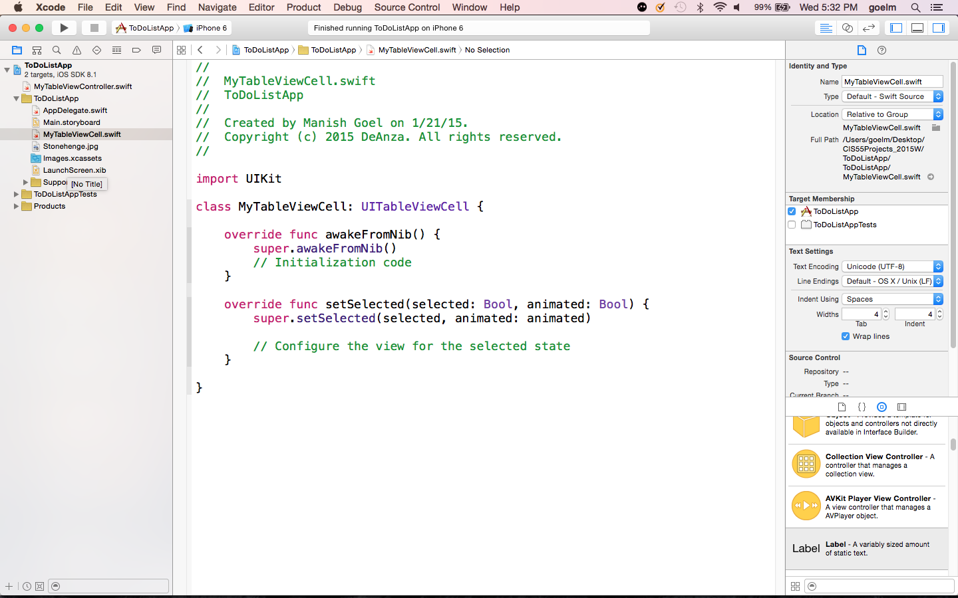

Slide 46
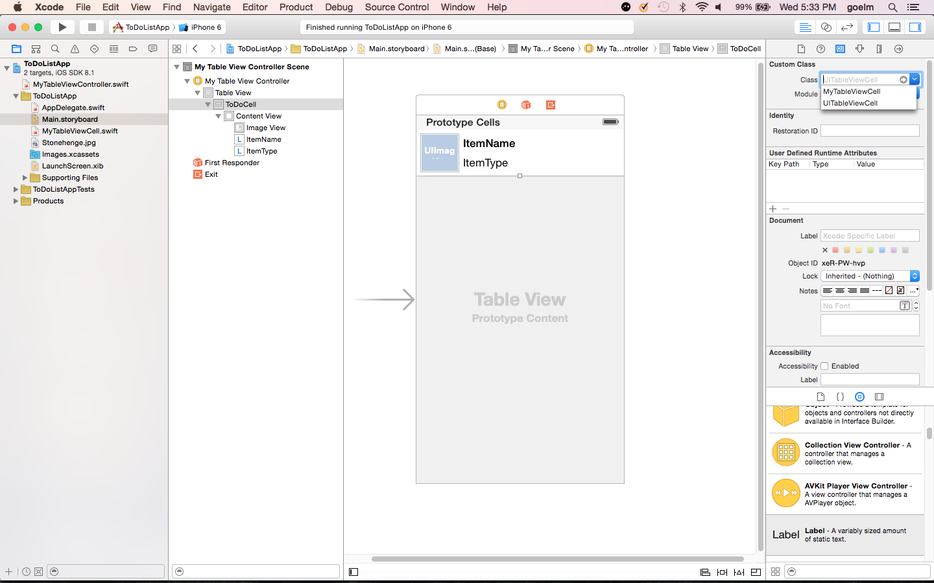

Slide 47
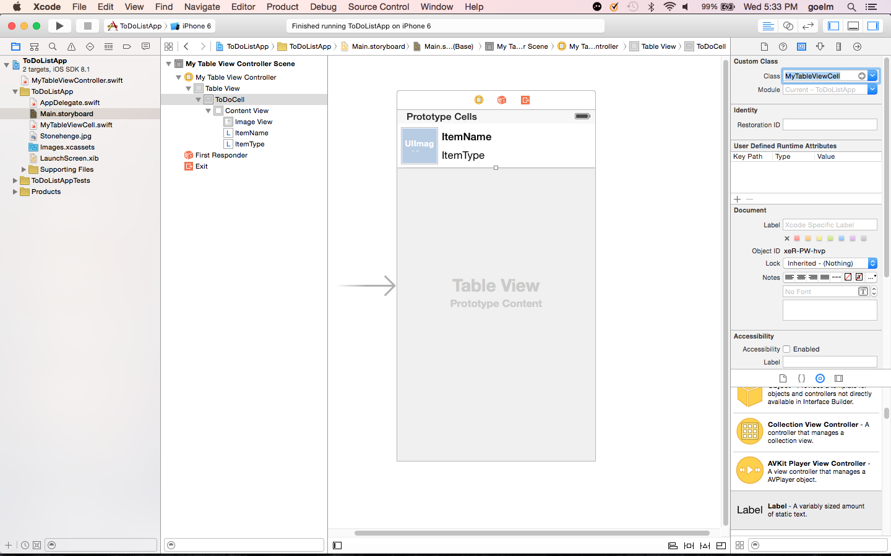

Slide 48
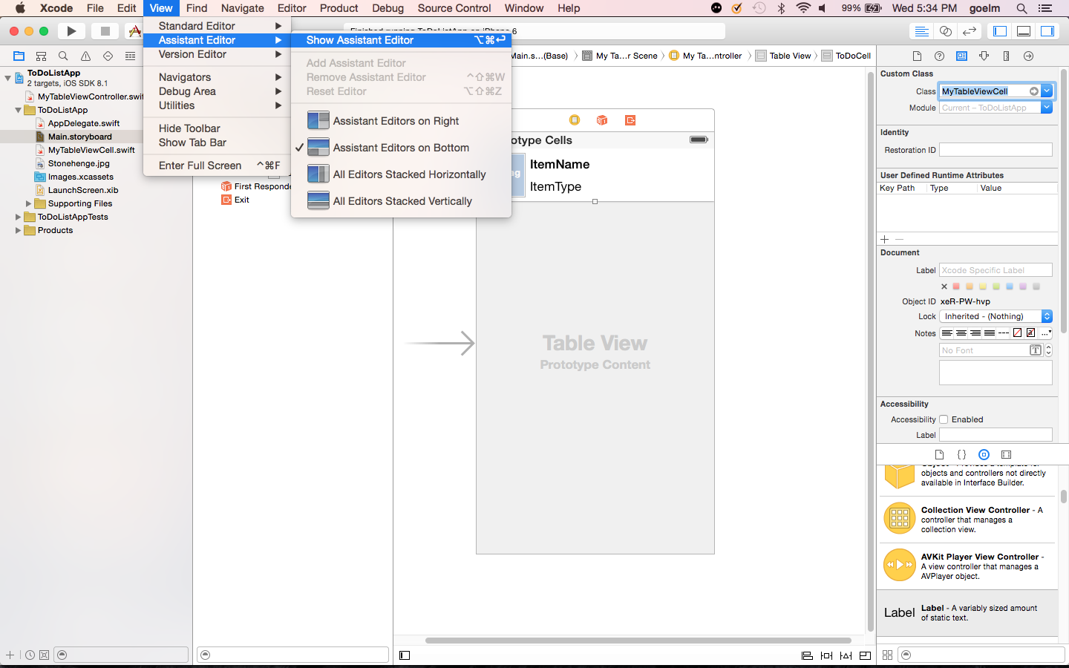

Slide 49
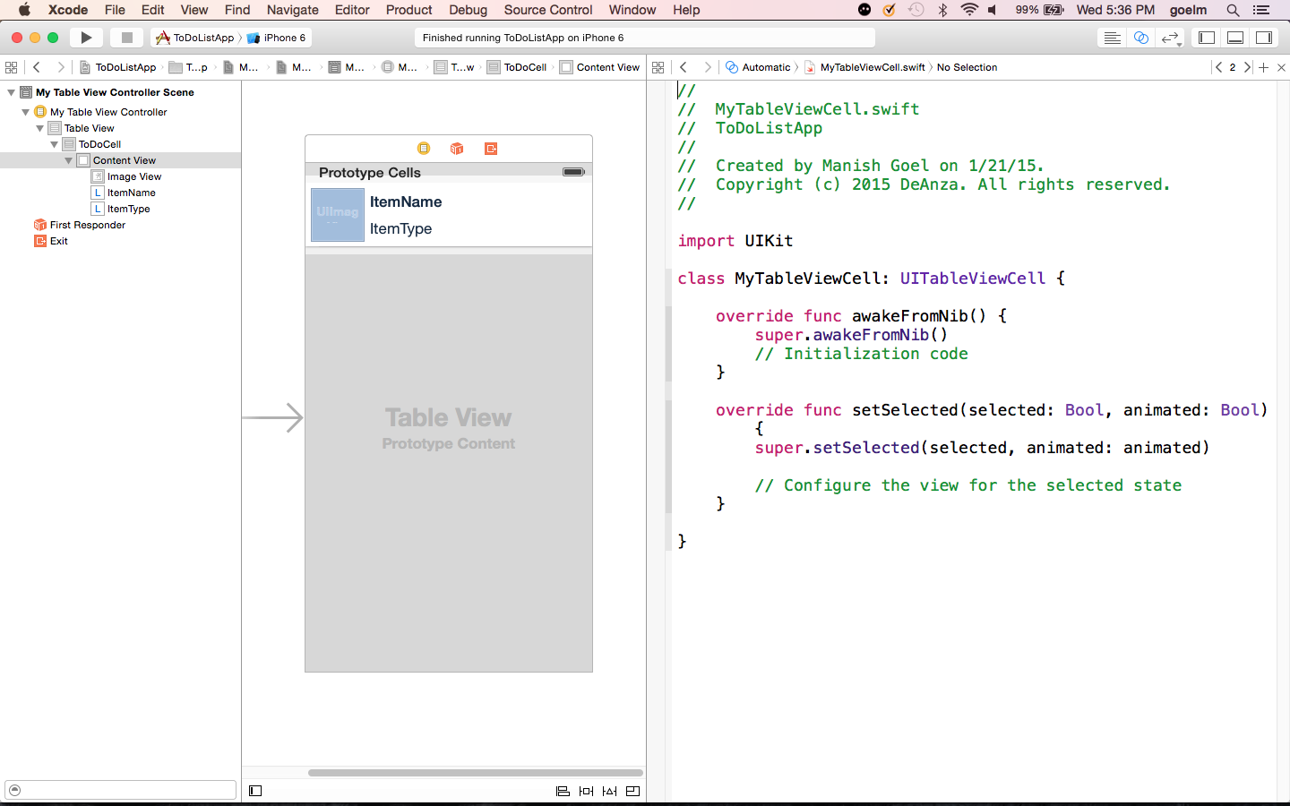

Slide 50
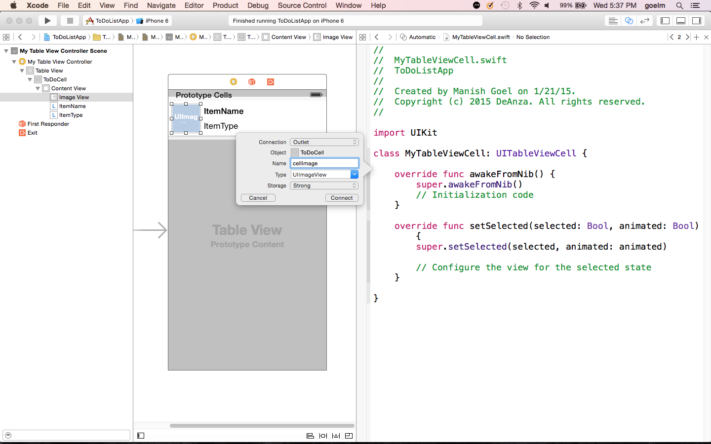

Slide 51
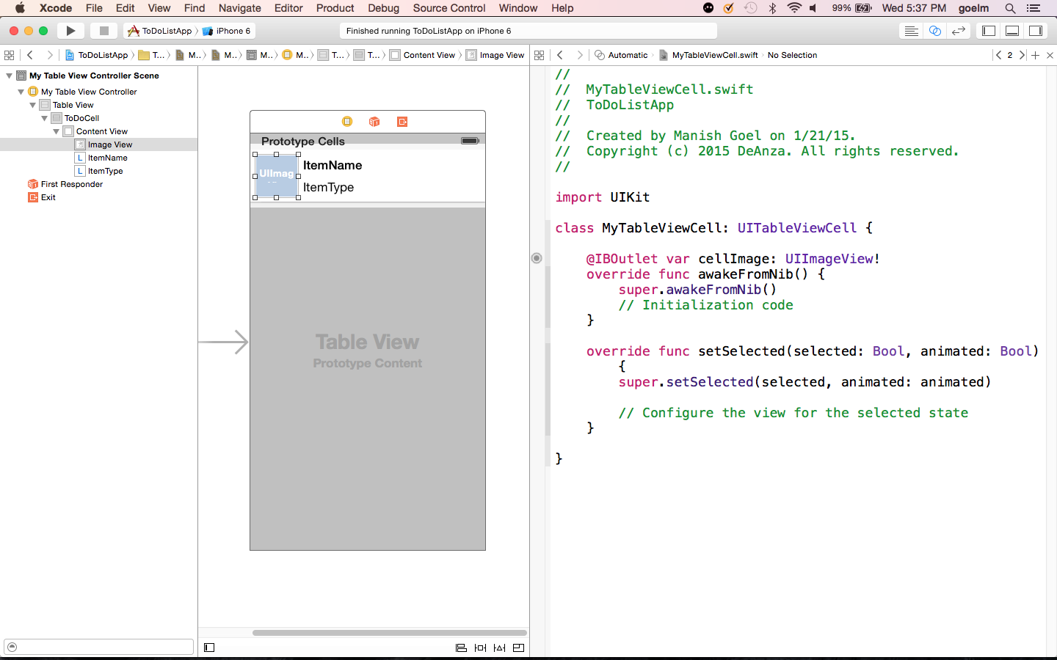

Slide 52
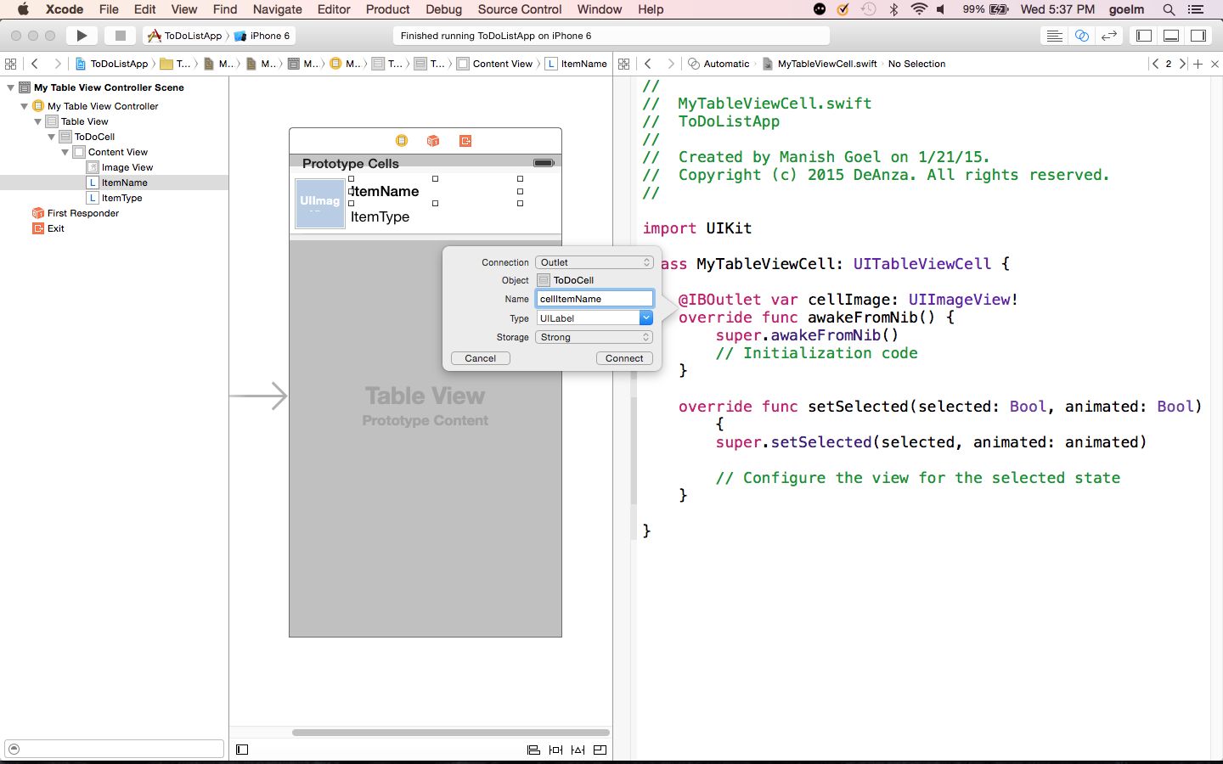

Slide 53
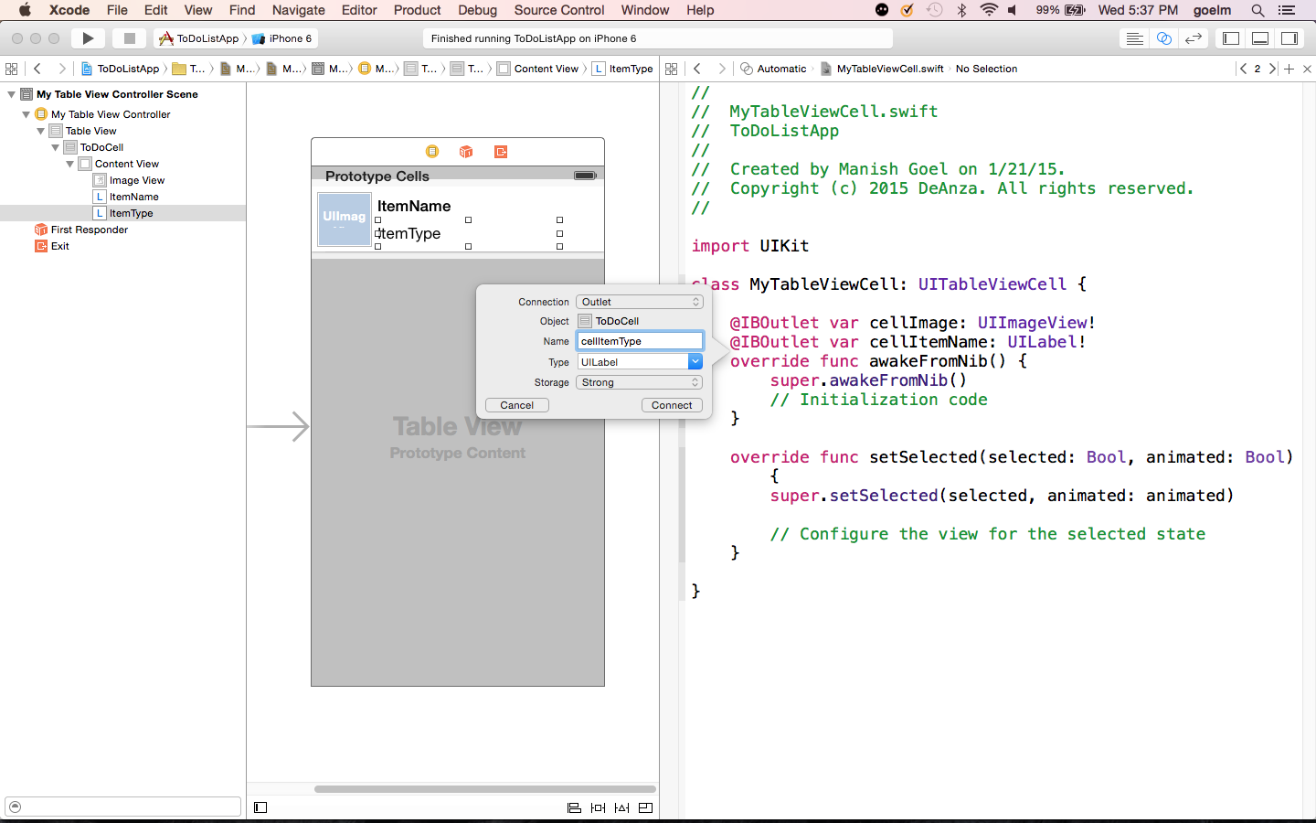

Slide 54
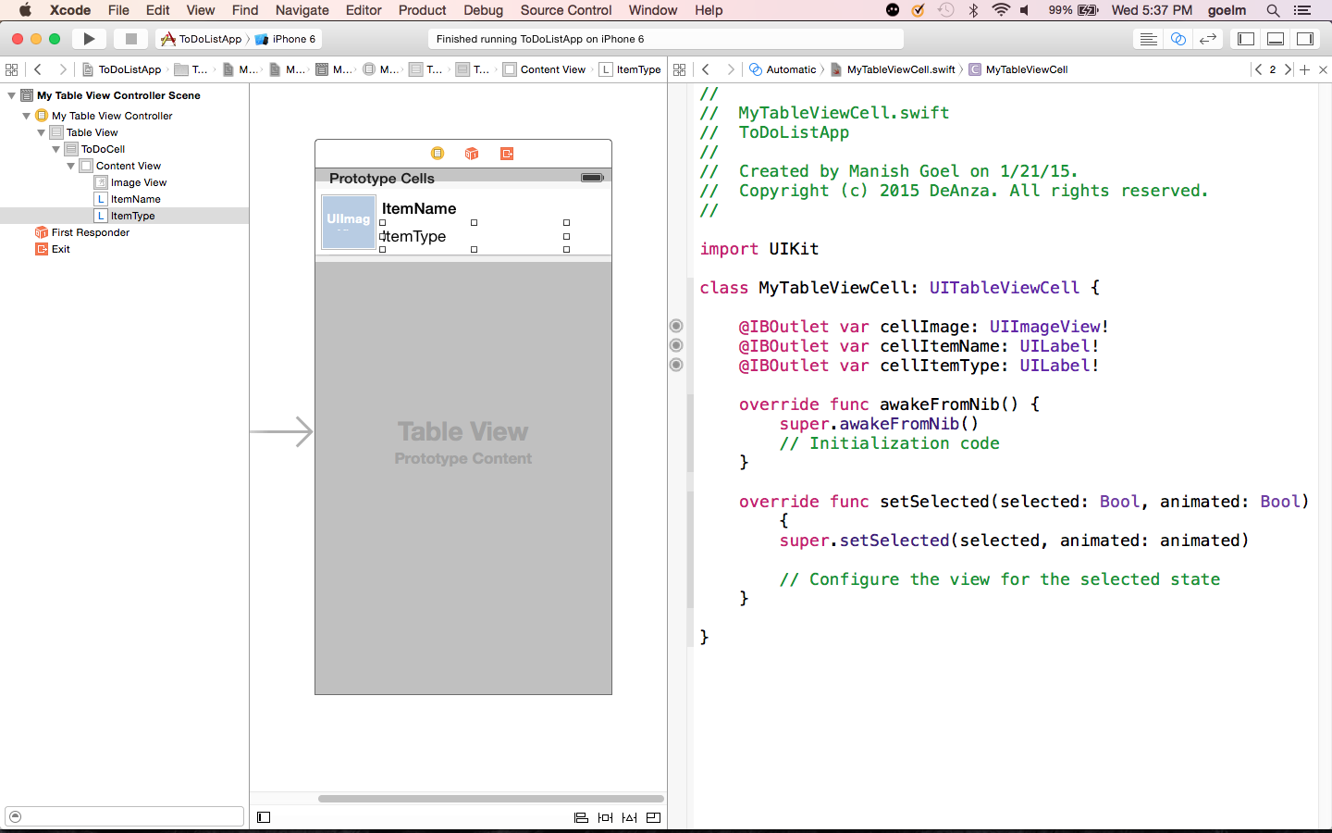

Slide 55
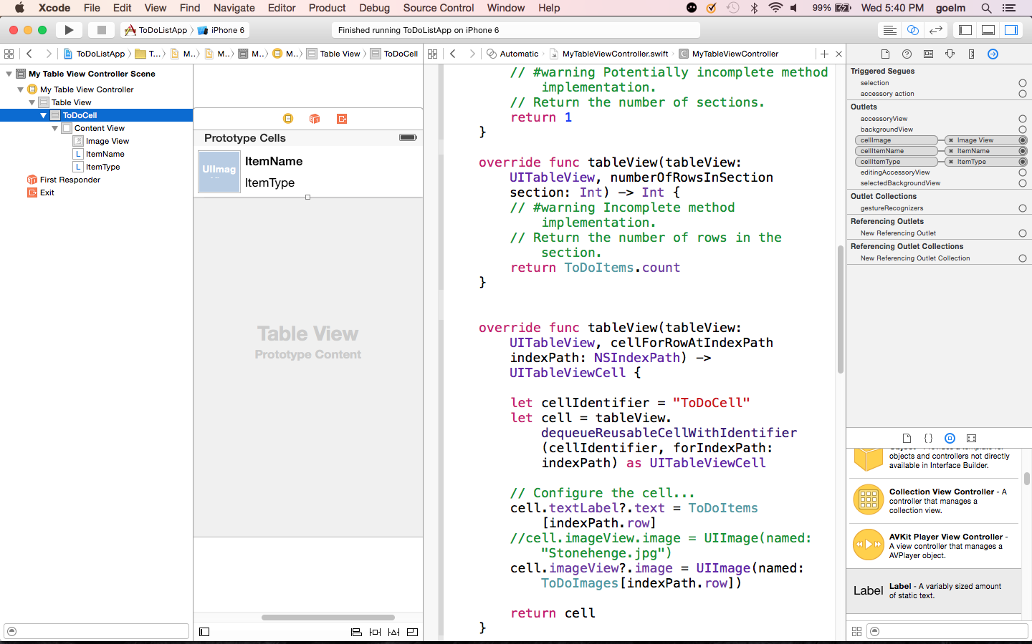

Slide 56


Slide 57


Slide 58


Slide 59


Slide 60


Slide 61


